Slide 1

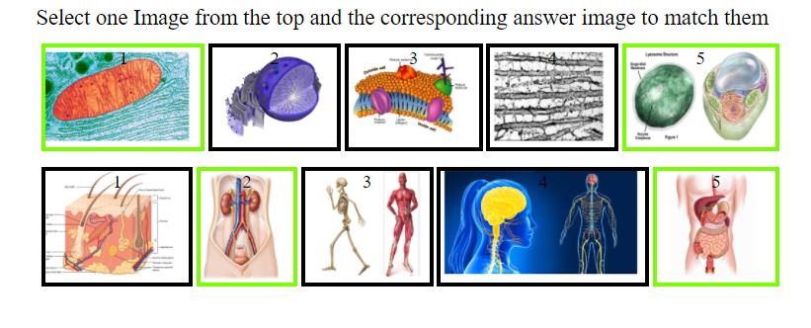
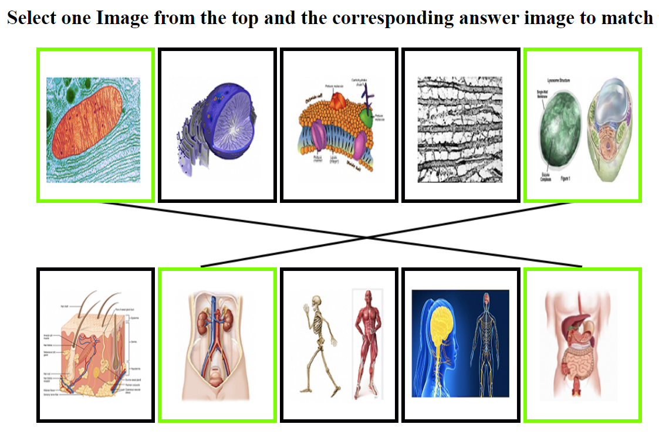
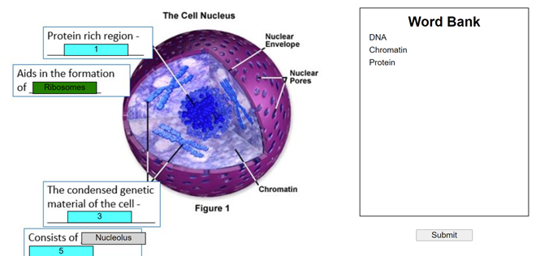
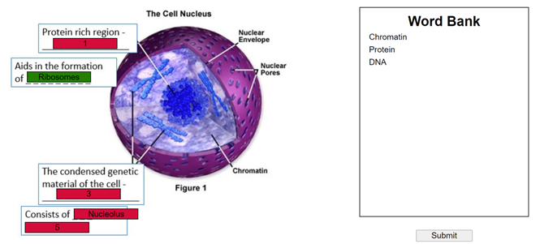
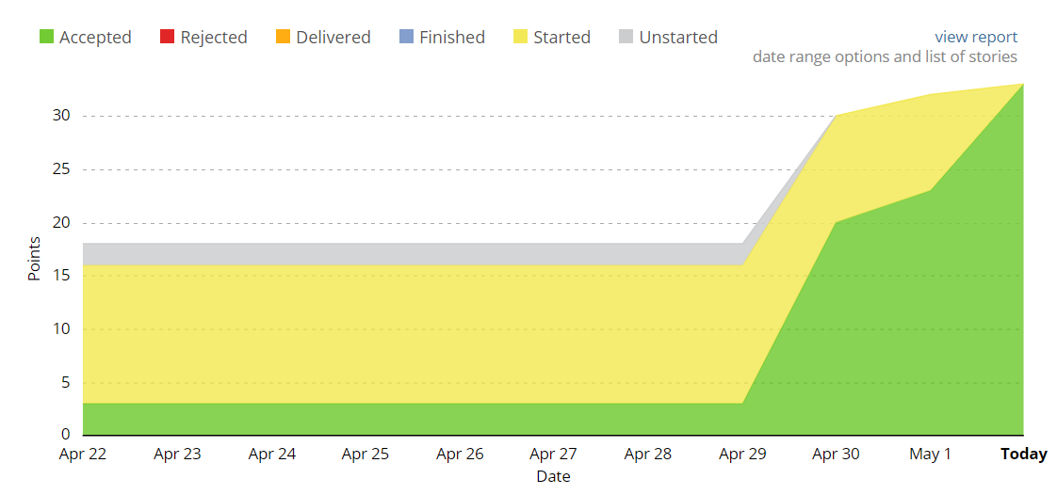
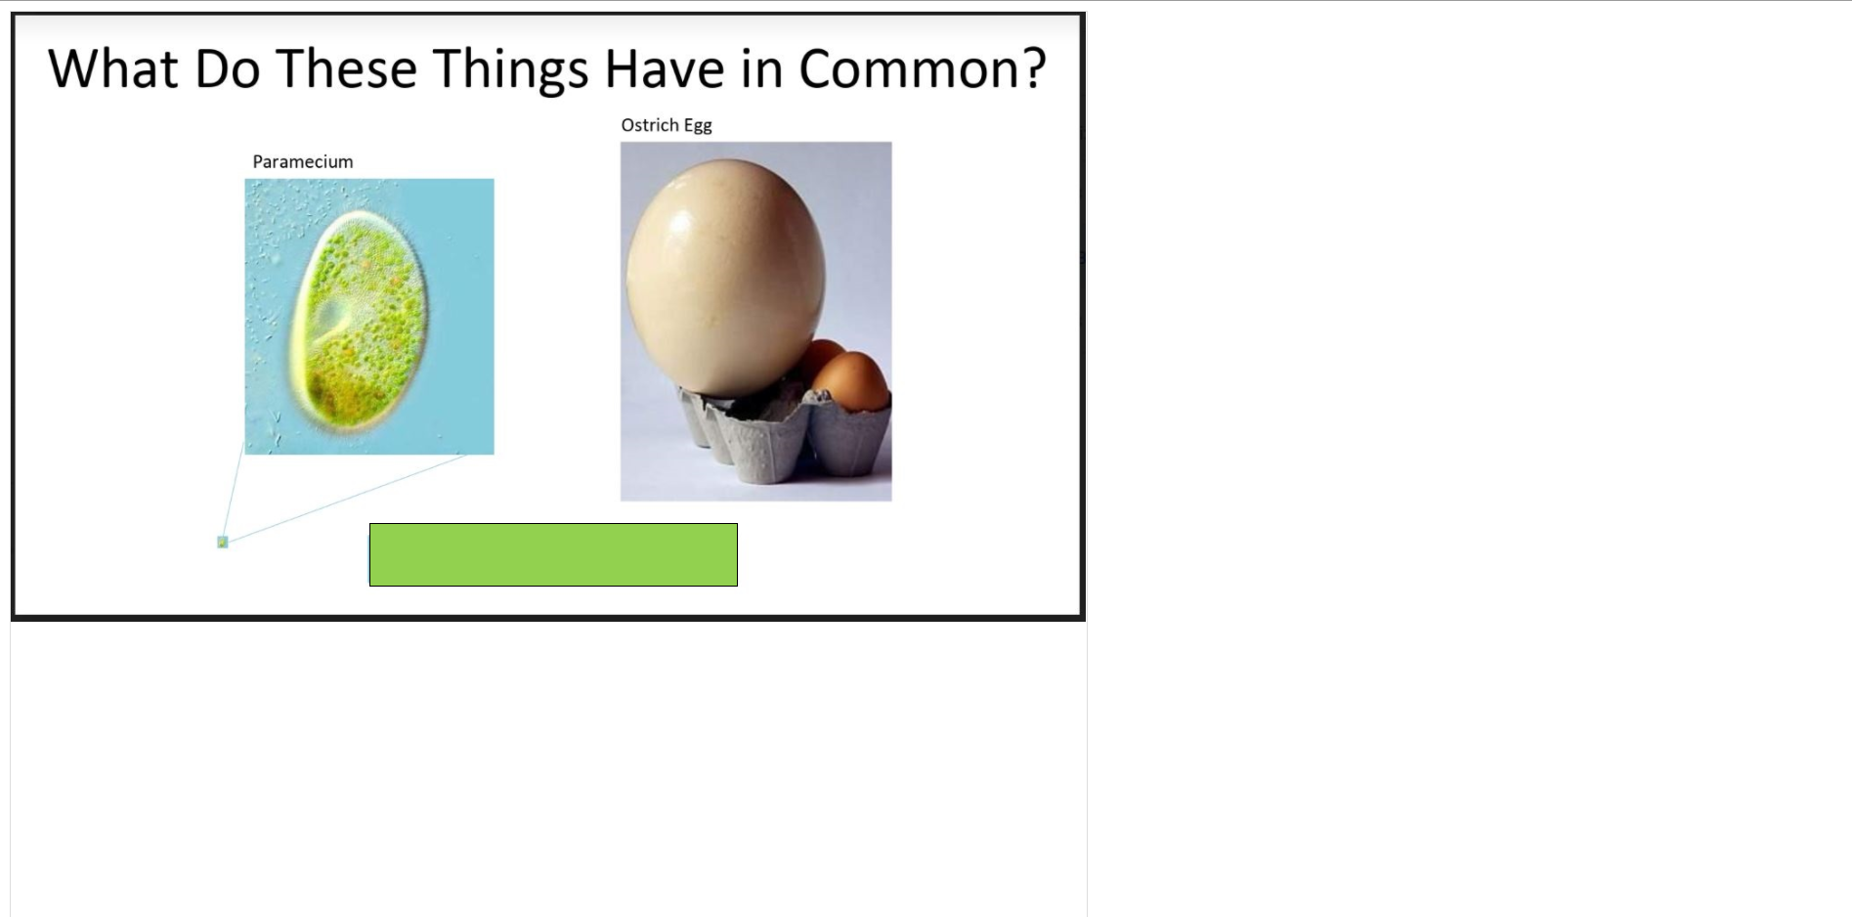
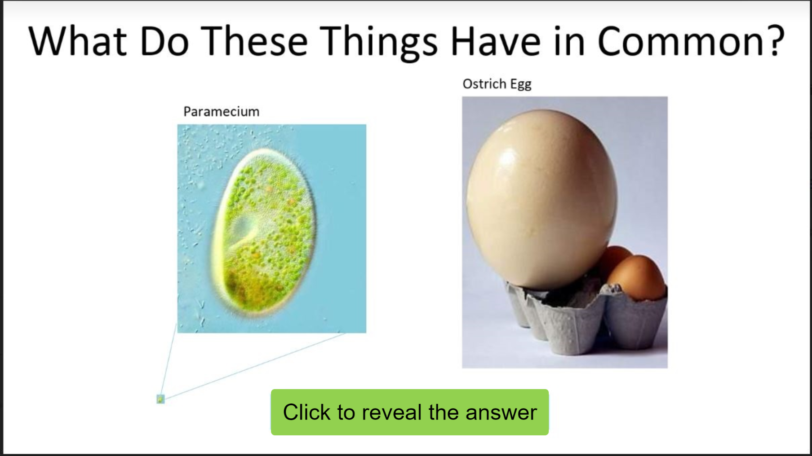
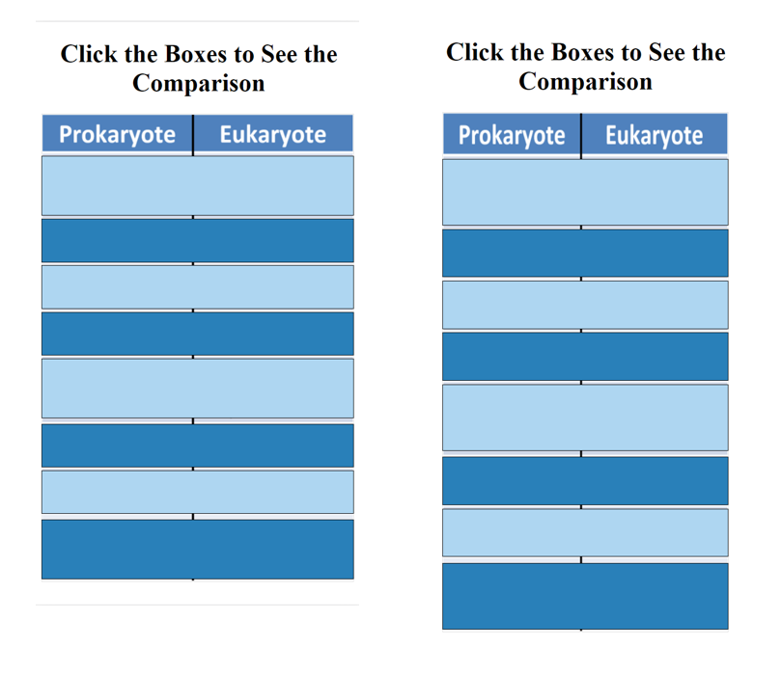
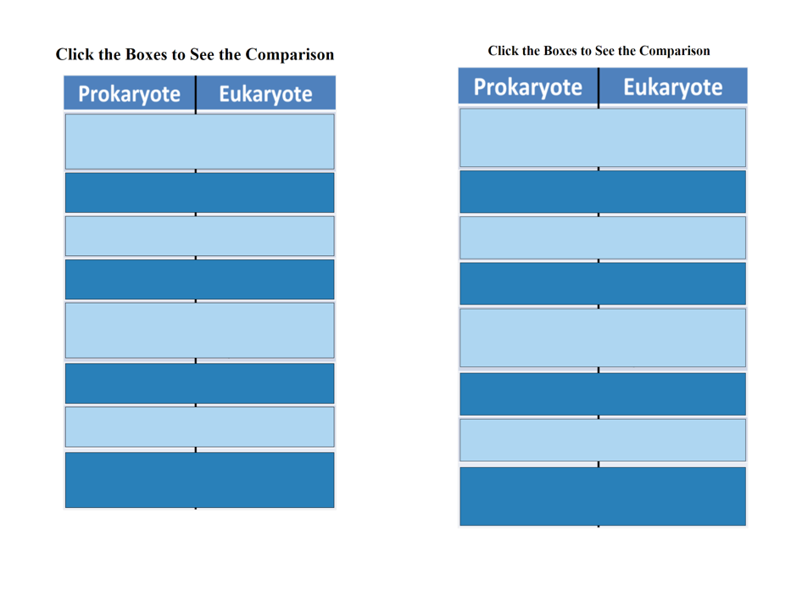
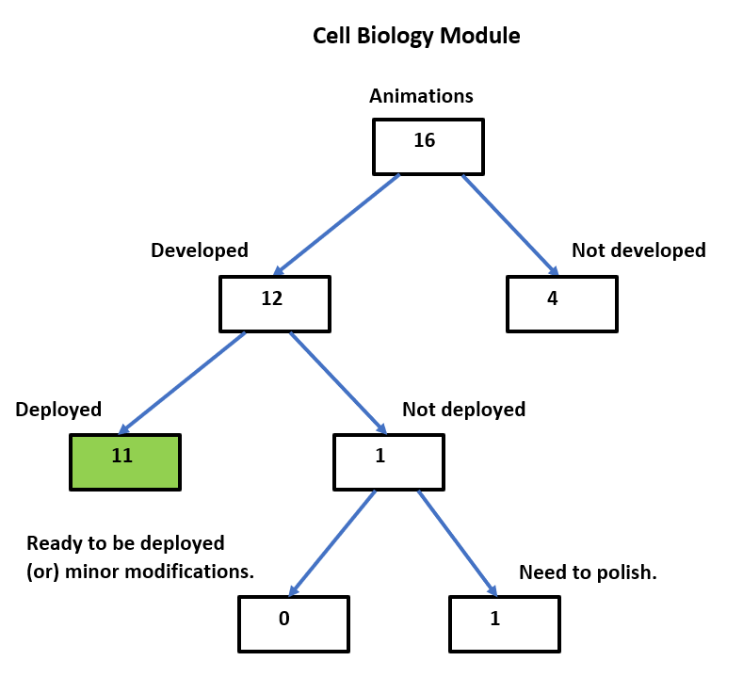
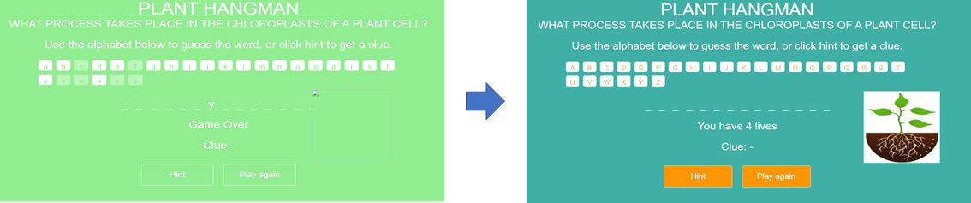
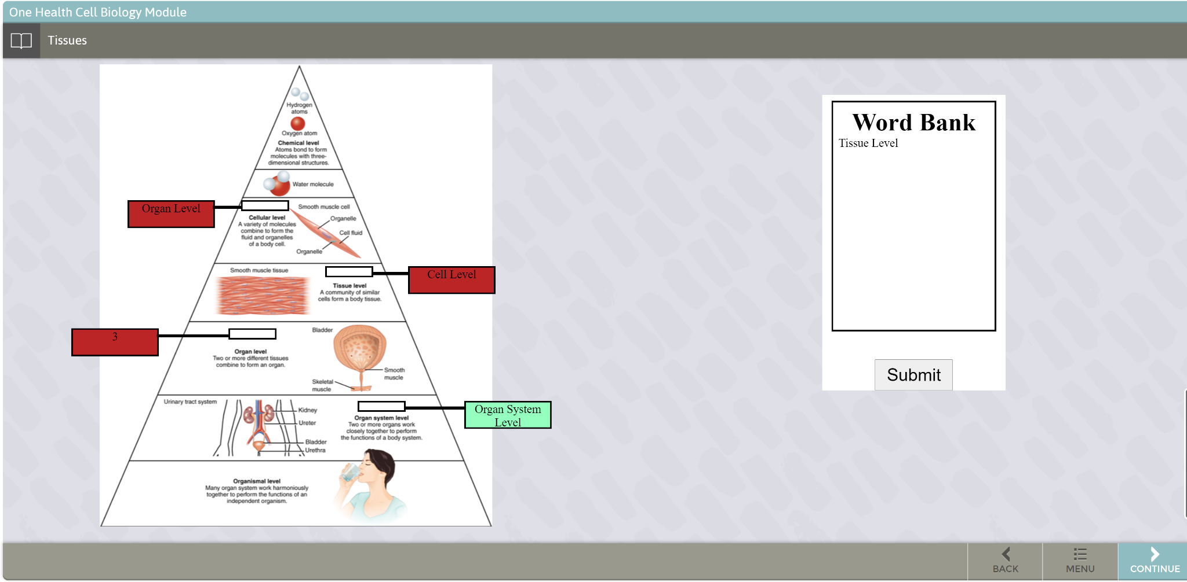
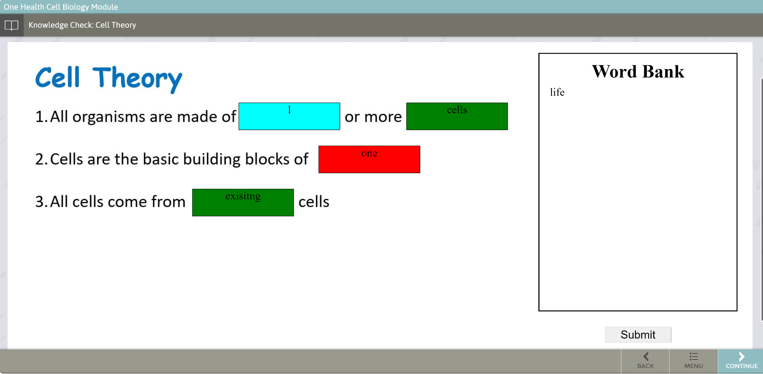
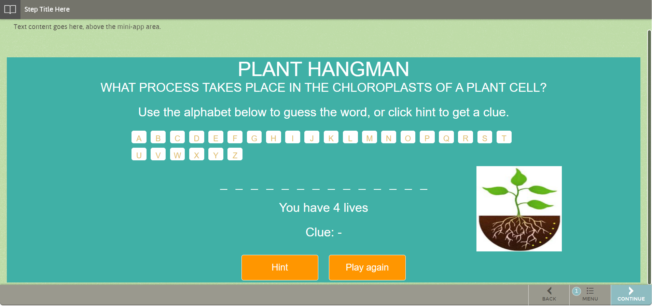
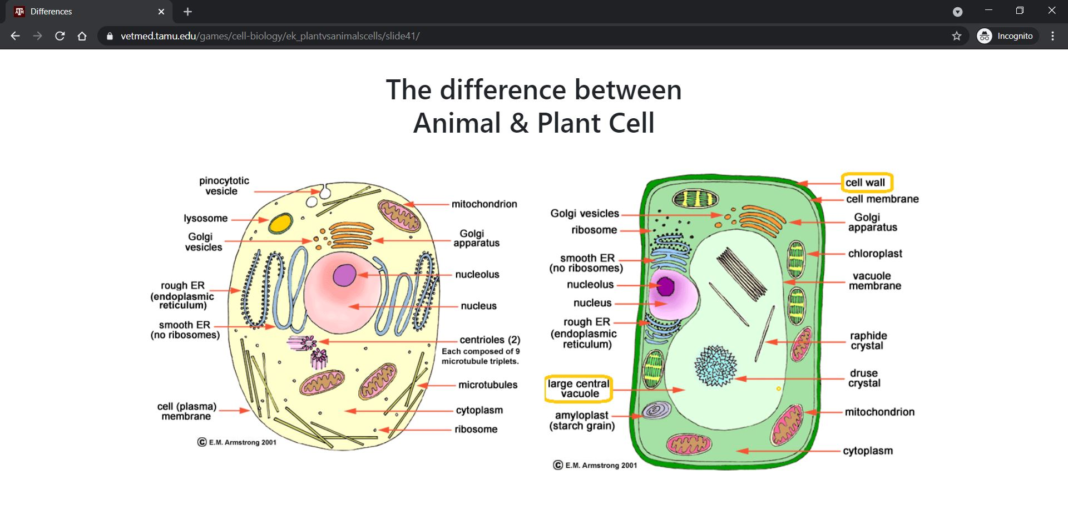
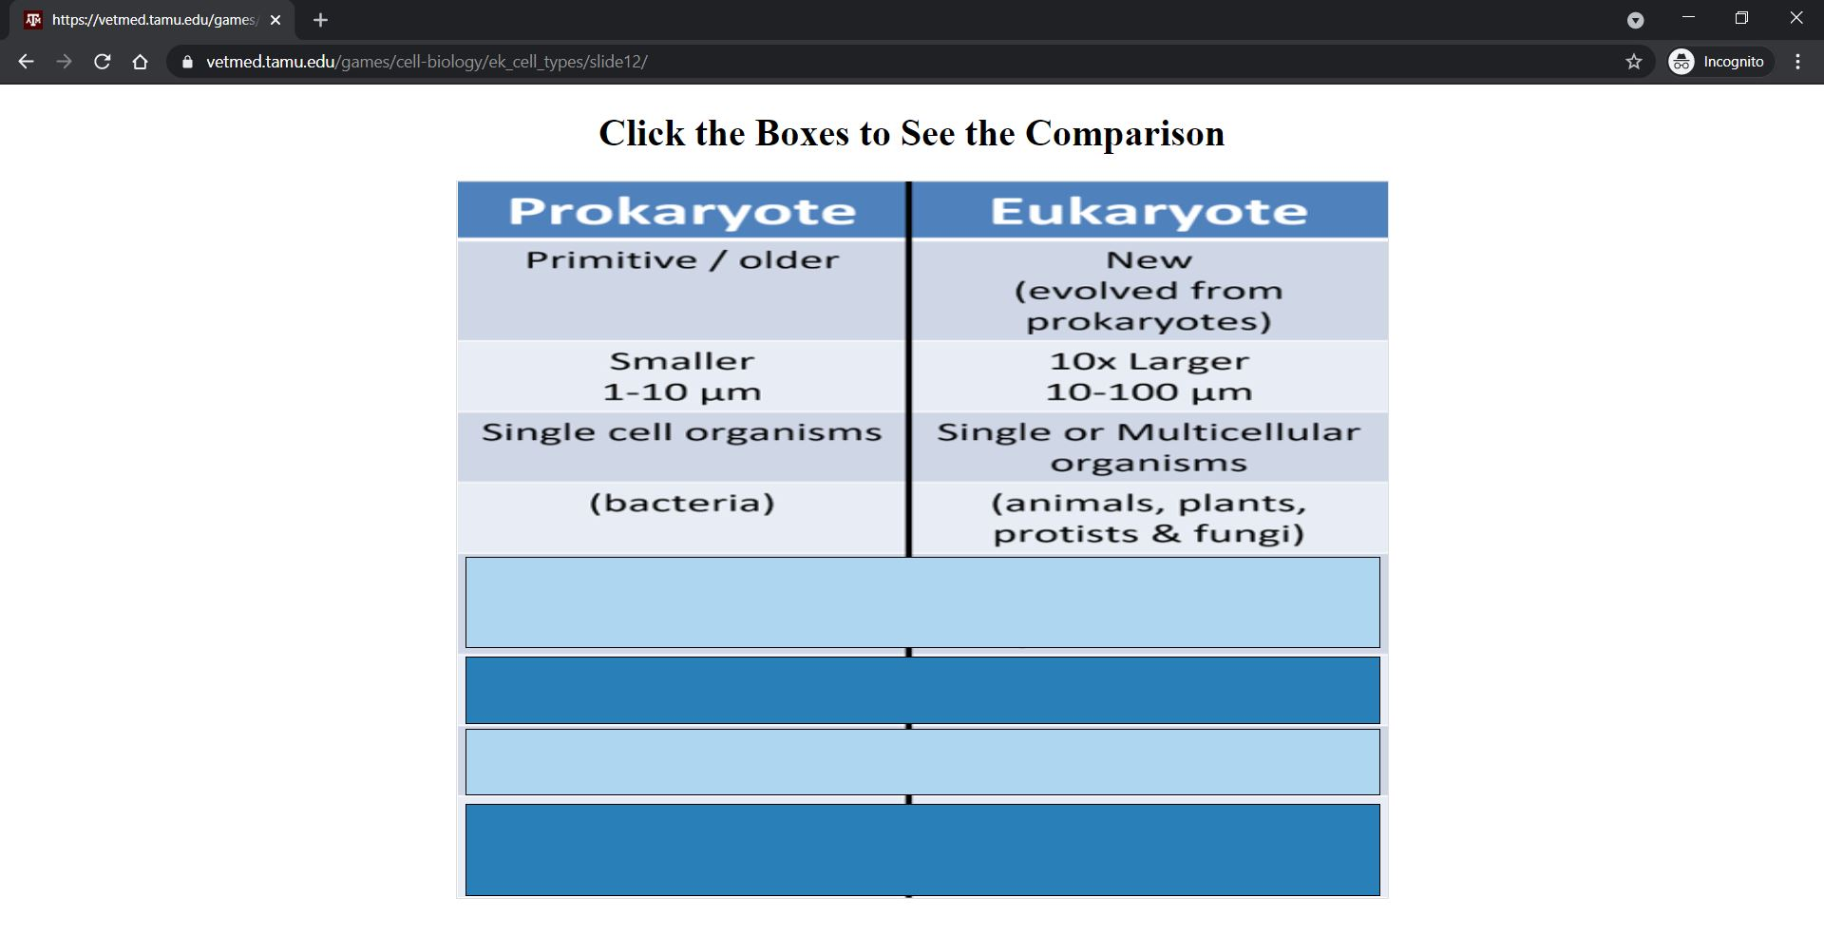
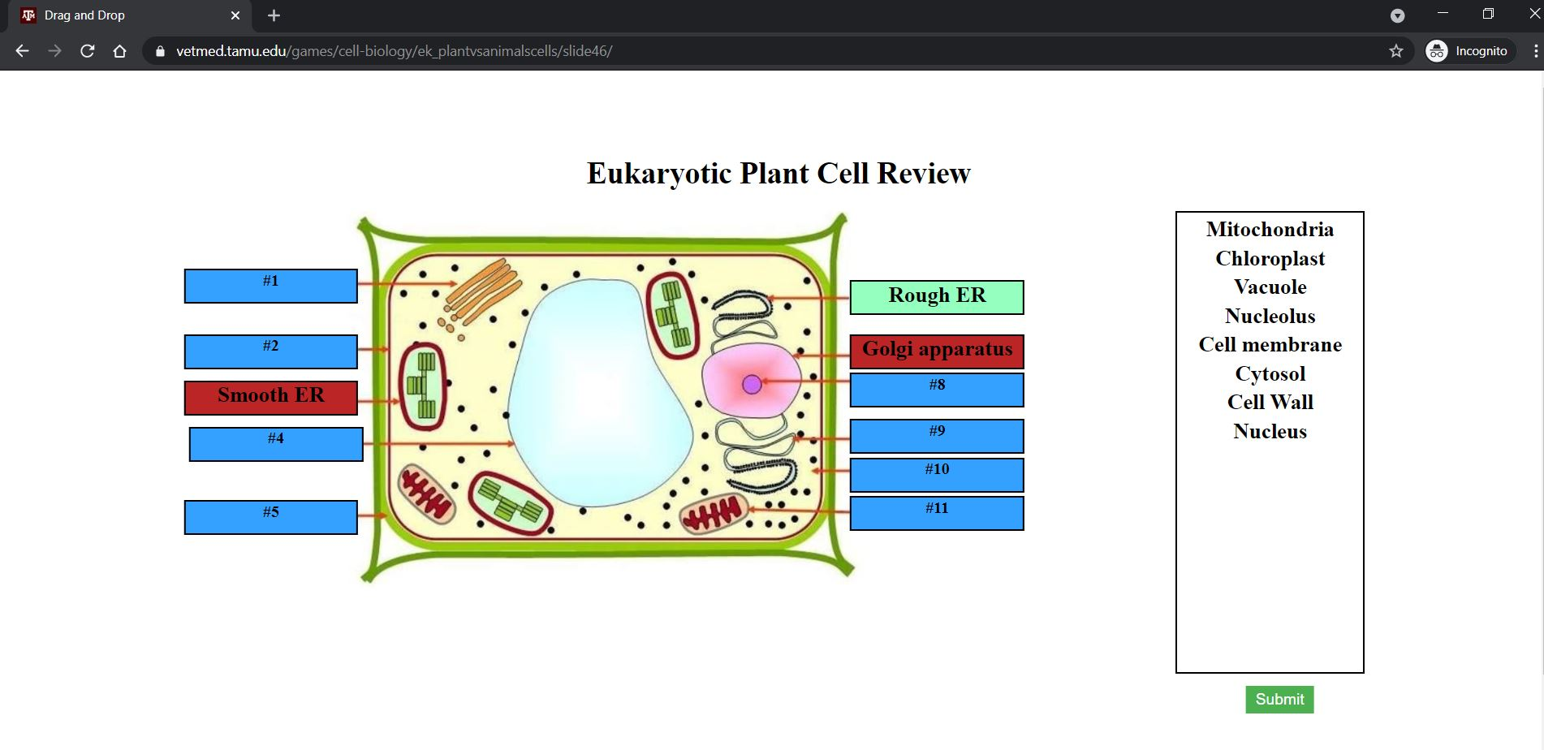
Animation in Cell Biology Learning Content I
Arjun Singh, Kenta Nakajima, Ching-Hsien Liu, Devi Sandeep Endluri, Lingaraju Vasuraju, Prajwal Das, Sri Teja Chamarthy
Department of Computer Science and Engineering, Texas A&M University
Introduction
Animation slides
Target customer: VetMed (Torri Whitaker / Hank Walker)
Goal: Aid middle school aged children to interactively learn biological concepts
Requirement: Create JS/Jquery applications to be dispersed throughout a “module” built on an existing platform called “Stepstone” and WordPress based web site
Added matching lines for the correct matches. Figure below shows the previous version and the modified version.
Agile Workflow
Setting up WordPress
Verification of animations in StepStone and WordPress
Modifications to fix existing animations
Parameterizing animations
Making animations mobile
compatible
Deployment of animations in StepStone and WordPress based web site
Highlighted incorrect answers and adjusted the exposition. Figure below shows the previous version and the modified version.
Getting familiar with legacy code
Inventory of developed animations and their deployment status
This shows our velocity graph. Animations are deployed to StepStone, WordPress environment post Iteration 2, so most of points are accepted only after Iteration 2
Added ‘Click to reveal’ instruction and corrected the resizing issues. Figure below shows the previous version and the modified version.
Inventory
Adjusted view to be mobile compatible (left for iPhones, right for iPads). In the PC, the table size is adjusted automatically corresponding to the current window size.
Created and maintained an inventory of animations and their deployment status
Number of total animations deployed increased to 11 from 2
Improved the UI and adjusted view for mobile compatibility. Figure below shows a comparison between previous and modified version.
StepStone deployment
Goals Achieved / Impact
.
We successfully realized our main goal, which was to improve the existing animations to allow students to learn interactively and in an enjoyable way.
We have also created an inventory of the existing animations for the VetMed staff to assist them in their future improvements in the Cell Biology module.
The existing animations have also been made compatible for mobile devices and have been thoroughly tested on stepstone and wordpress.
To parameterize we have created a separate JS file and for the animation we define variables and choose from the parameterized JS file.
Web deployment
Acknowledgements
We would like to thank Dr. Hank Walker and Shravani Shridhar for their help and inputs throughout the project, and Daniel Shuta (StepStone developer), Harshita in deploying our animations.

